Slide 1
Module 3: Individual Peacekeeping Personnel
Lesson
3.2
Respect for Diversity

Slide 2
Relevance
UN peacekeeping operations are diverse
Local population has own culture
Success dependent on respect for diversity
UN Core Pre-Deployment Training Materials 2017

Slide 3
Learning Outcomes
Learners will:
Describe cultural differences and different kinds of diversity
Explain how “respect for diversity” contributes to effective peacekeeping
Describe strategies to improve communication
UN Core Pre-Deployment Training Materials 2017

Slide 4
Lesson Overview
Diversity
Cultivating an Awareness of Diversity
Assumptions, Prejudices & Stereotypes
UN Core Value of Respect for Diversity
Practicing Respect for Diversity
UN Core Pre-Deployment Training Materials 2017

Slide 5
Learning Activity
3.2.1
Diversity Line
Instructions:
Stand against the wall and listen to the instructor
The instructor will read statements which are either true or false
Walk up to the line on the floor when a statement is true for you
Consider common ground and differences between you and others
Time: 10 minutes
UN Core Pre-Deployment Training Materials 2017
Notes:
CPTM 3.2.4
Instructor: Qs on assumptions and stereotypes (link with lesson content)

Slide 6
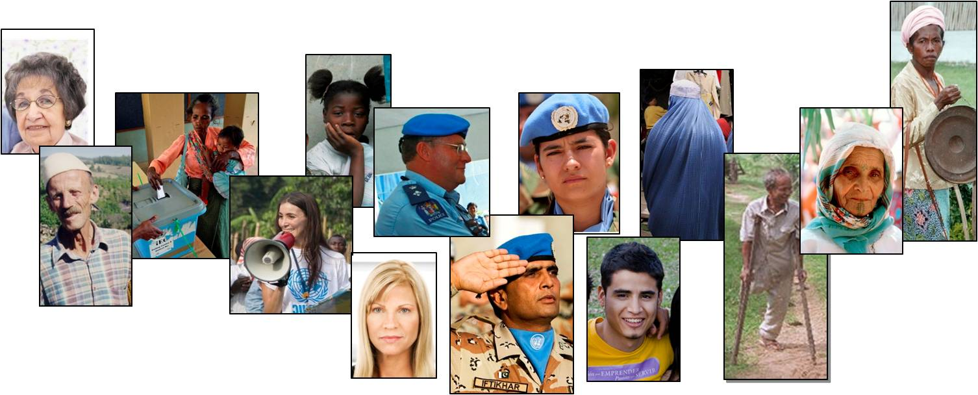
1. What is Diversity?
Diversity means “variety” – refers to things that are different from each other
UN Core Pre-Deployment Training Materials 2017

Slide 7
1. What is Diversity?
Core personality
Fixed attributes
Personal circumstances and choices
Organizational aspects
UN Core Pre-Deployment Training Materials 2017

Slide 8
2. Cultivating an Awareness of Diversity
UN Core Pre-Deployment Training Materials 2017

Slide 9
Learning Activity
3.2.2
Diversity Iceberg
Instructions:
Consider the “differences” between individuals who deploy to a mission
What differences are obvious?
What differences are less obvious?
Time: 15 minutes
Brainstorming: 10 minutes
Discussion: 5 minutes
UN Core Pre-Deployment Training Materials 2017
Notes:
CPTM 3.2.2

Slide 10
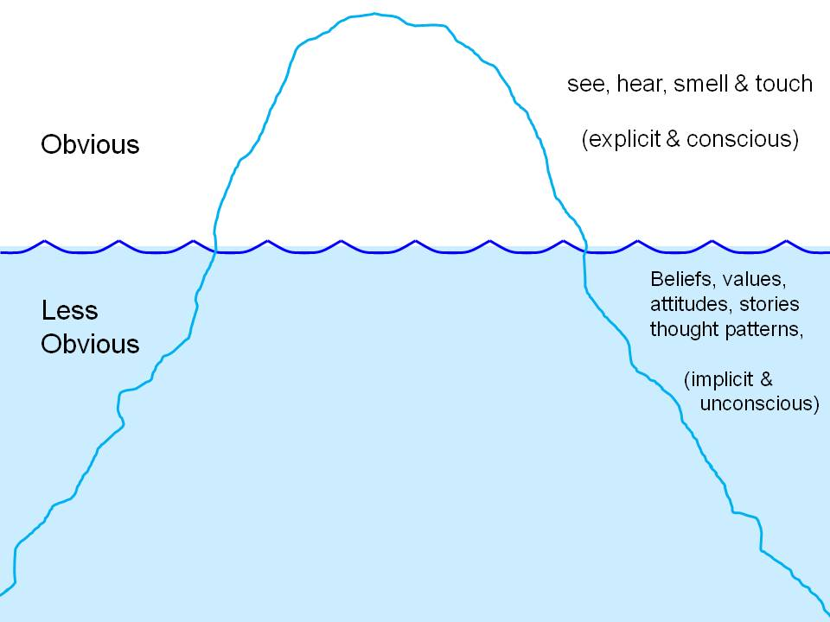
2. Cultivating an Awareness of Diversity
UN Core Pre-Deployment Training Materials 2017

Slide 11
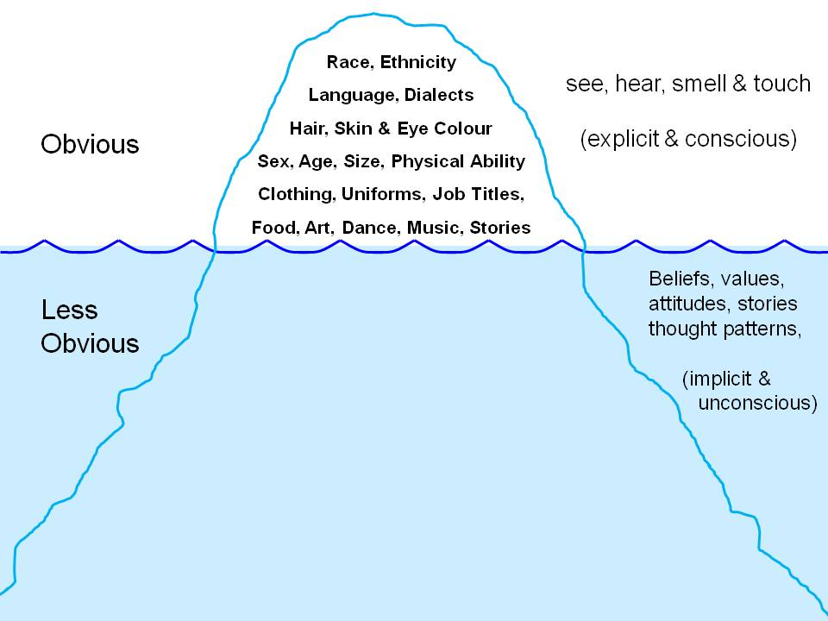
2. Cultivating an Awareness of Diversity
UN Core Pre-Deployment Training Materials 2017

Slide 12
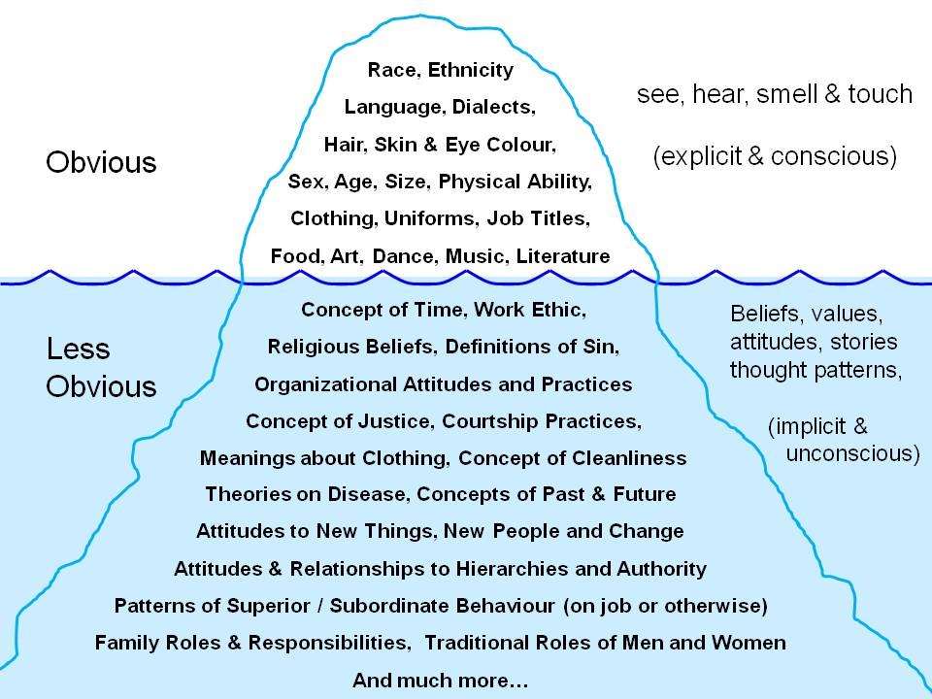
2. Cultivating an Awareness of Diversity
UN Core Pre-Deployment Training Materials 2017

Slide 13
3. Assumptions, Prejudices & Stereotypes
Stereotypes = beliefs about all people of a certain type
Prejudices = judgments or opinions that are formed without real knowledge or examination of facts – prejudices are generally negative
UN Core Pre-Deployment Training Materials 2017

Slide 14
4. UN Core Value of Respect for Diversity
Work effectively with people from all backgrounds
Treat all people with dignity and respect
Treat men and women equally
Show respect for diverse points of view
Examine own biases and behaviours
Do not discriminate against any individual or group
UN Core Pre-Deployment Training Materials 2017

Slide 15
5. Practicing Respect for Diversity
Attitudes regarding authority and management
Body language and gestures
Religion, spirituality and faith
Family, clan and tribal connections
Dress code
Concepts of time
Communication
Learning from others
UN Core Pre-Deployment Training Materials 2017

Slide 16
Learning Activity
3.2.3
Practicing Respect for Diversity
Instructions:
Consider each key area of diversity
What differences must you be aware of?
How does practicing respect in these key areas of diversity contribute to success in your work?
Time: 5 minutes
Brainstorming: 3 minutes
Discussion: 2 minutes
UN Core Pre-Deployment Training Materials 2017

Slide 17
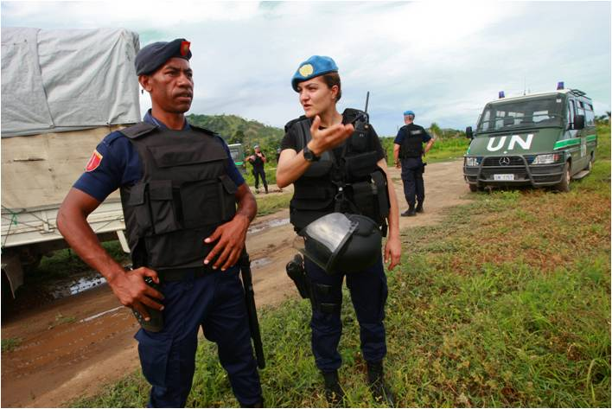
Attitudes Regarding Authority and Management
Remember that the difference may be cultural
Take time to understand what is happening
Be clear and respectful in your communications and expectations
UN Core Pre-Deployment Training Materials 2017

Slide 18
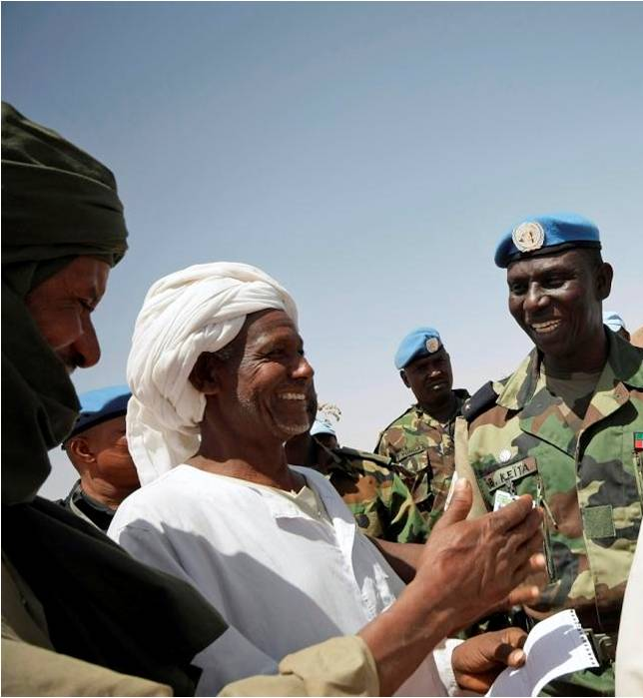
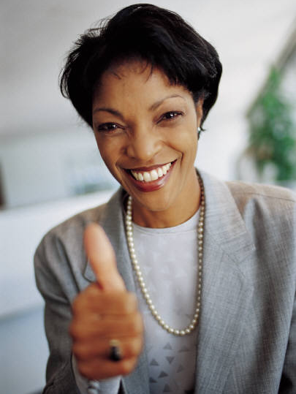
Body Language and Gestures
Observe and acquaint yourself with what is culturally appropriate
Ask colleagues for advice as needed
UN Core Pre-Deployment Training Materials 2017

Slide 19
Religion, Spirituality and Faith
Be aware of different religious beliefs and customs, particularly local ones
Practice respect for all religious beliefs
Practice respect for religious artifacts and places of worship
UN Core Pre-Deployment Training Materials 2017

Slide 20
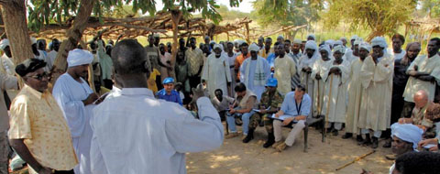
Family, Clan and Tribal Connections
Pay respect to elders
Understand family ties
Understand local roles and traditions for men and women
UN Core Pre-Deployment Training Materials 2017

Slide 21
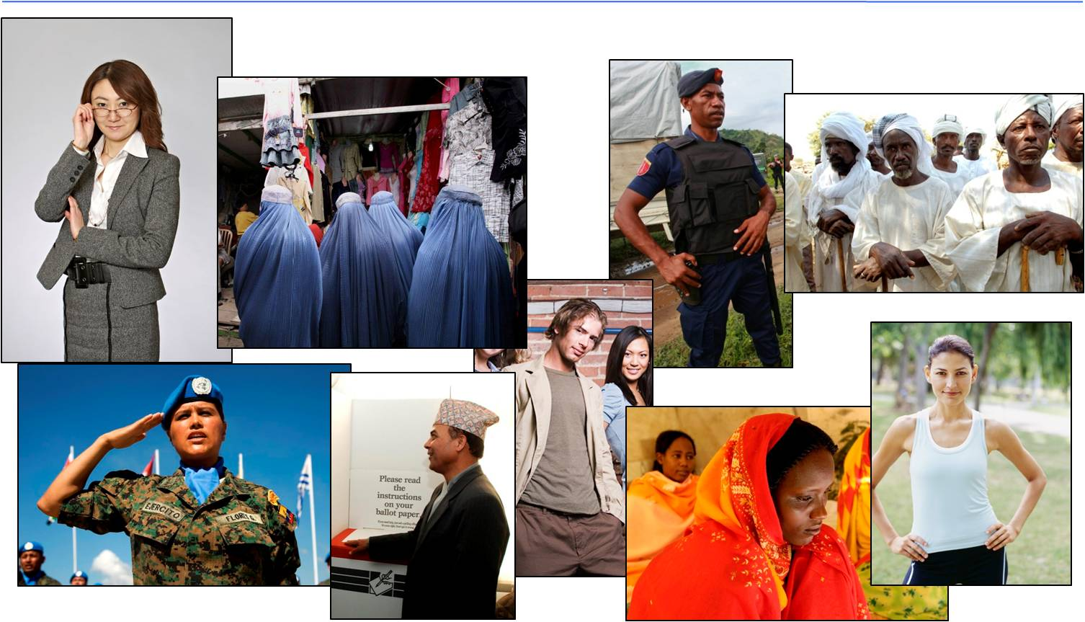
Dress Codes
Be aware of local cultural norms and climate
Adapt yourself to local dress codes
UN Core Pre-Deployment Training Materials 2017

Slide 22
Concepts of Time
Do not over generalize about any group’s way of perceiving or managing time
Reserve judgment about the meaning behind different attitudes and practices regarding time
UN Core Pre-Deployment Training Materials 2017

Slide 23
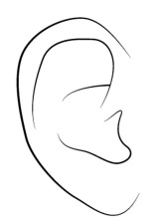
Communication
SENDER
MESSAGE CHANNEL
RECEIVER
The channel through which the message moves
VERBAL, NON-VERBAL, WRITTEN
“What I mean”
Message
“What I understand”
Message communicated through filter of LANGUAGE, IDIOMS, NORMS, VALUES
Message
interpreted
through filter of LANGUAGE, IDIOMS, NORMS, VALUES
UN Core Pre-Deployment Training Materials 2017

Slide 24
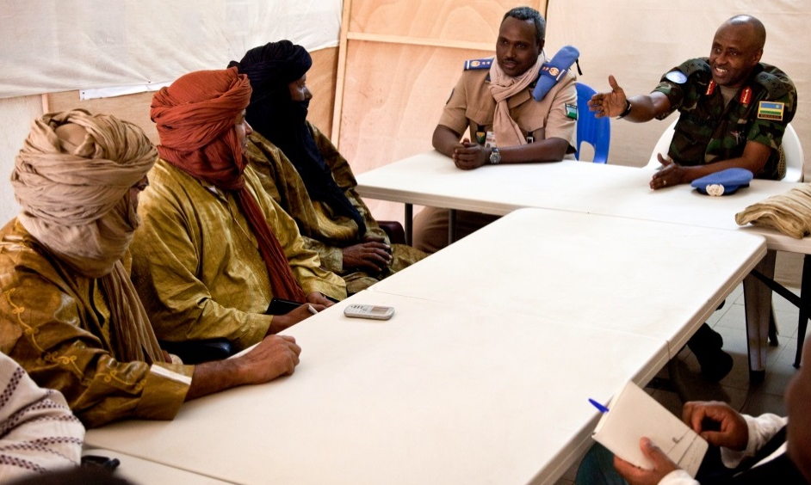
Communication
Use common words – avoid slang/idioms
Check you are understanding and understood
Allow time for people to speak – create opportunities for those speaking less
Be aware of tone of voice, body language
Practice patience
Be careful in your use
of humour
UN Core Pre-Deployment Training Materials 2017

Slide 25
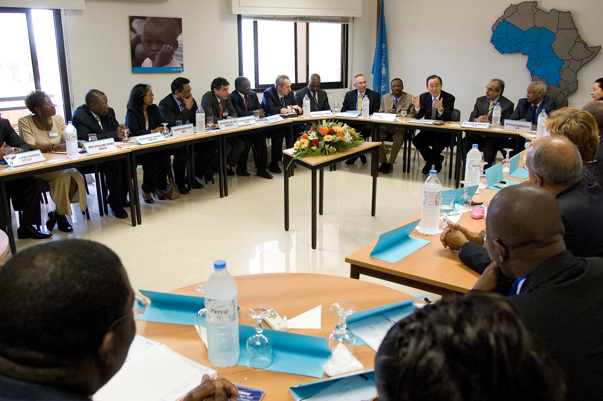
Learning from Others
All colleagues are a great resource
National colleagues – cultural information
Other colleagues – experiences from other missions, cultures

Slide 26
Summary of Key Messages
Diversity exists – mission environment, host country
“Respect for diversity” contributes to effective peacekeeping
Be aware of your communication – words, tone of voice, body language
UN Core Pre-Deployment Training Materials 2017

Slide 27
Questions
UN Core Pre-Deployment Training Materials 2017

Slide 28
Learning Activity
Learning Evaluation
UN Core Pre-Deployment Training Materials 2017

